Slide 1

Mini Project Presentation
on
A preprocessing approach at intelligent driving model car
Submitted by:
Rishik Mishra
Roll No: 181500569
Under the Supervision of:
Mr Piyush Vashisht
Dept. of Computer Engineering & Applications, IET,
GLA University, Mathura

Slide 2
Contents
Introduction | 3
Motivation | 4
Problem Statement | 5
Dataset | 6
Proposed Method | 8
Image Enhancement | 10
Region of interest extraction | 13
Parkinson’s Classification | 15
Experimental Result | 17
Software Used | 20
Conclusion | 21

Slide 3
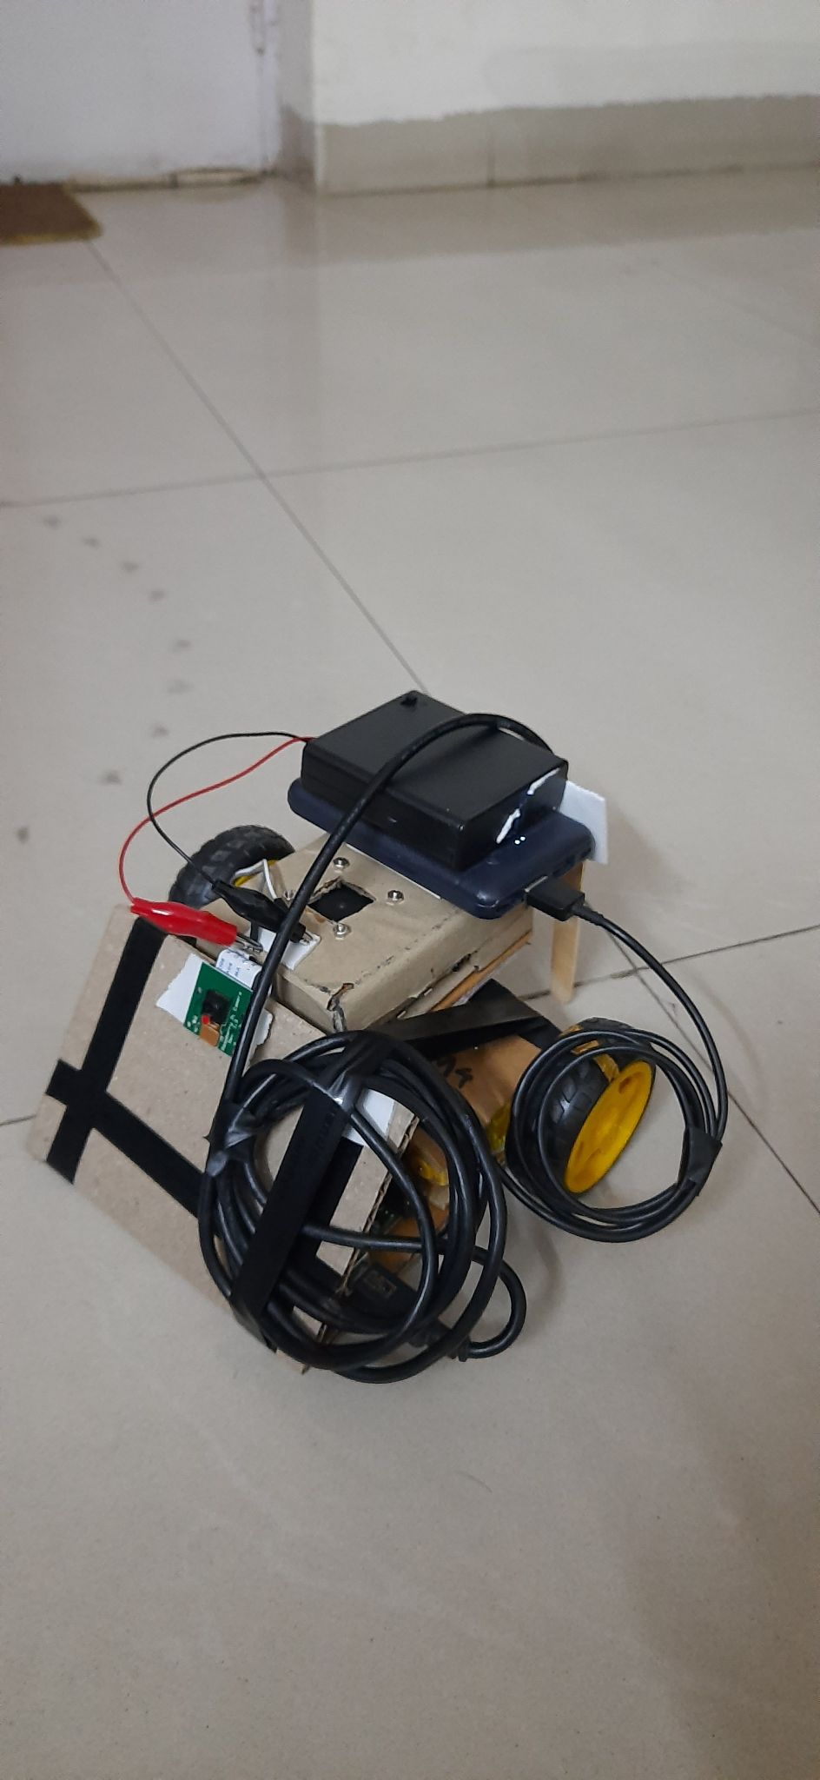
Introduction
Intelligent driving is not just an avenue for commercial vehicles like cars and trucks but also for industrial,healthcare and academic uses.Intelligent driving refers to the ability of a bot to drive without the aid of humans and to intelligently identify obstacles and course.We have thus implemented intelligent driving in a bot ,meant to be used in a variety of scenarios ,from hospitals,schools,emergency situation to vehicular assistance.The intelligent base of our driving system consists of a raspberry pi and an arduino uno,very readily available and inexpensive boards which also add the benefit of the project moving towards open source.The method we intend to implement works well for any situation as instead of processing and learning on raw images we train our model on semantically segmented masks.

Slide 4
Problem statement
The objective of intelligent driving cars is to create a fully functional automated car that is able to reduce human effort and better traffic flow. intelligent-driving cars were created to provide benefits to the society we live in, such as providing transportation for those people who are not able to drive because of age or physical impairment or automating the work in dangerous workplaces.

Slide 5
Dataset
For the first phase of this study.ie. in the semantic segmentation stage we have used the Mapillary Vistas Dataset, a novel, large scale street-level image dataset containing 25,000 high resolution images annotated into 66 object categories with additional, instance-specific labels for 37 classes. Annotation is performed in a dense and fine-grained style by using polygons for delineating individual objects. The dataset is 5× larger than the total amount of fine annotations for Cityscapes and contains images from all around the world, captured at various conditions regarding weather, season and daytime.

Slide 6
Dataset
For the traffic sign detection stage we have used the TSDD dataset which includes 10000 traffic scene images containing many kinds of signs. The images are collected under different time,weather conditions,lighting conditions as well as moving blurring.

Slide 7
Dataset
For the final training we have used a custom dataset created on a specifically created scenario with the model car driven manually on 2 separate tracks and the 2 minute videos of each track from the camera mounted on the model car,resulting in 24000 images along with additional data like ir sensor data and steering angles.

Slide 8
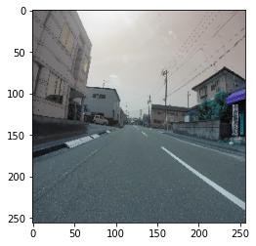
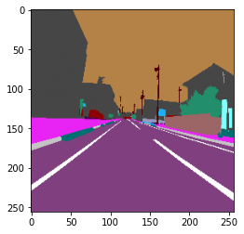
Segmentation Dataset Sample

Slide 9
Proposed Method
Our method works by a cooperative operation between an arduino which acts as a drive unit and a raspberry pi which acts as the brain.The arduino is connected to an h-bridge which controls 2 geared dc motors and 1 servo motor, the arduino is further connected to 3 ir sensors which measure the distance between the objects on 3 sides.The arduino sends data to the raspberry pi through usb bus and receives serial instruction from the pi after he raw dat has been processed and a prediction has been made.

Slide 10
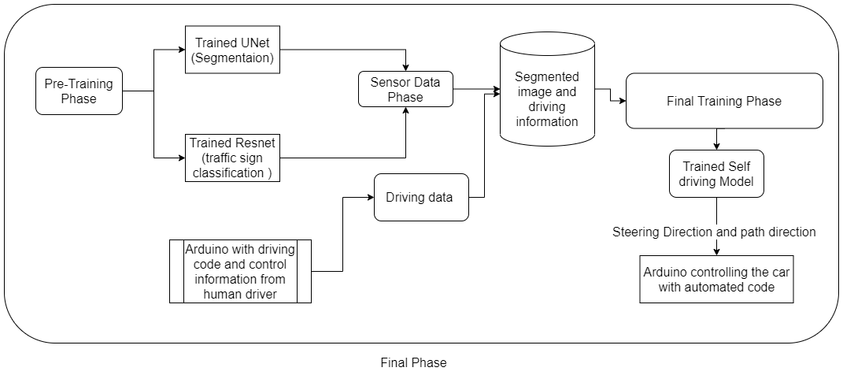
Fig 1.3 Proposed Methodology

Slide 11
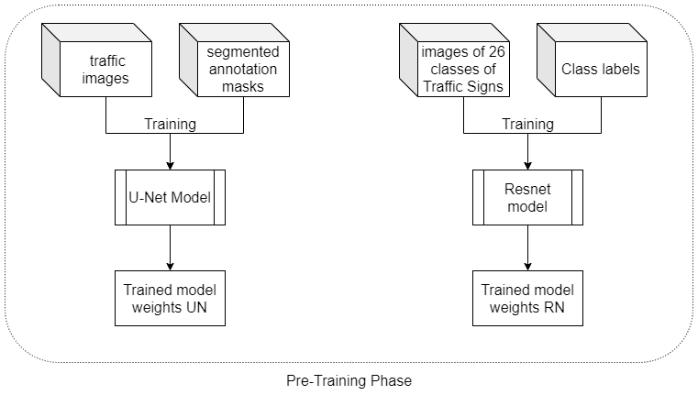
Pre Training Phase
For the training of our final model we need the images to be available in a processed form instead of in the raw form.For this step/ we first semantically segment the images into various objects (from 1 of 128) so the images from any scenario could be generalised.Then from the segmented images the traffic sign segment is extracted and sent to a classifier for the classification between various types of traffic signs

Slide 12
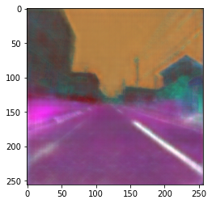
The above images represent the original image, predict image segments and ground truth segments for an image of the road predicted by UNet model trained by us.

Slide 13
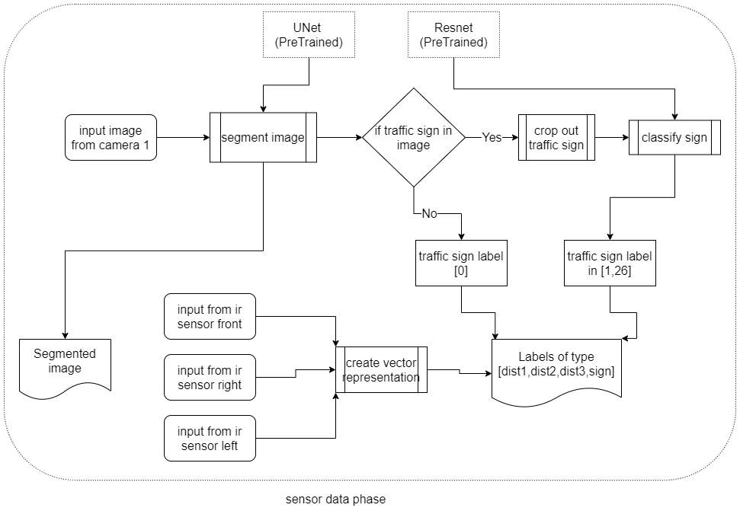
Traffic light classification stage
MAPGI - The modular adaptive preprocessing for gastrointestinal tract image
Proposed by Coger et al.
The images that the MRI dataset provides contain multiple slides of the brain and different studies might use different thickness of the slides . the most influencing region of the brain in the
detection of Parkinson’s is the Substantia Nigra region , we localize the Substantia Nigra region to classify between PD and no PD ,to improve the accuracy of the localization we separate the images containing the Substantia Nigra region ,In this study we use a custom CNN for automatically differentiating Substantia Nigra in image and no Substantia Nigra in image

Slide 14
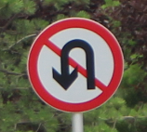



000_0002.png;165;151;23;12;149;138;0;
000_0003.png;128;122;22;14;116;105;3;
000_0010.png;80;73;14;8;67;63;5;
000_0011.png;186;174;36;15;155;157;17;
The results of this stage as mentioned above produce the image size,sign bounding top right and bottom left coordinates and the class of the image

Slide 15
S.No | Item Name
1. | 150 RPM dual shaft geared motor
2. | 5000 mAh lithium polymer power bank
3. | 5V 0.2A Cooling Fan
4. | Raspberry Pi 4 b
5. | Raspberry pi 4 heatsink
6. | Battery holder case 4x 1.5V AA
7. | IR Proximity Sensor
8. | NiMH 3000mAh battery
9. | Raspberry pi 5MP camera
10. | L293D Motor Shield
11. | 16GB MicroSDHC
12. | Arduino Uno
13. | Wheels 2.5’’
14. | Laptop
15. | BreadBoard
16. | Jumper Cables(m-m,f-m,f-f)
17. | USB A to USB B cable
18. | LED
Hardware Required

Slide 16
Software used
Tensorflow,Keras
OpenCV
Google Drive
Google Colab
Python libraries(numpy,matplotlib etc)
Google sheets
Arduino IDE

Slide 17
Thank You

